Slide 1
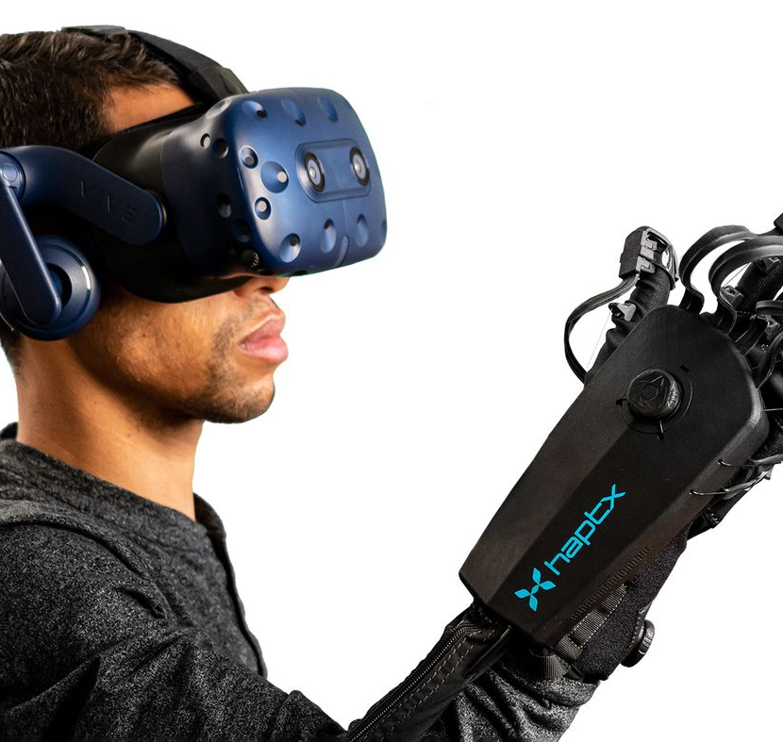

Haptic technologies for the Metaverse
Nathan Poret, Valentin Pain, Benjamin Brifault, ARTHUR Lecras, Dove-Steeve Bingo Kpognon, Pierre Garrido
Notes:
Haptic technologies for the Metaverse
This is the what we going to introduce you here with my team
*By changing the diapositive* So why, we chose that topic?

Slide 2
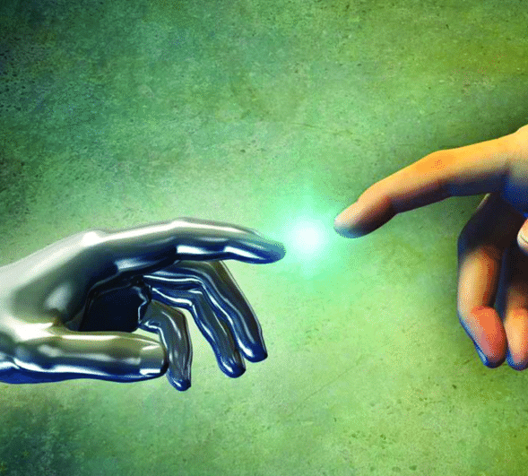
Why?
Notes:
Why? Because,
The era of virtual reality has begun. The human senses begin to be immersed in another virtual world. Nowadays, we can simulate perfectly sight and hearing. But today, other simulations of senses are being developed, such as touch. However, many haptic technologies exist and a choice among them is necessary to perceive which technology will provide the best experience to the user.
Knowing this, it is useful to consider the following problematics

Slide 3
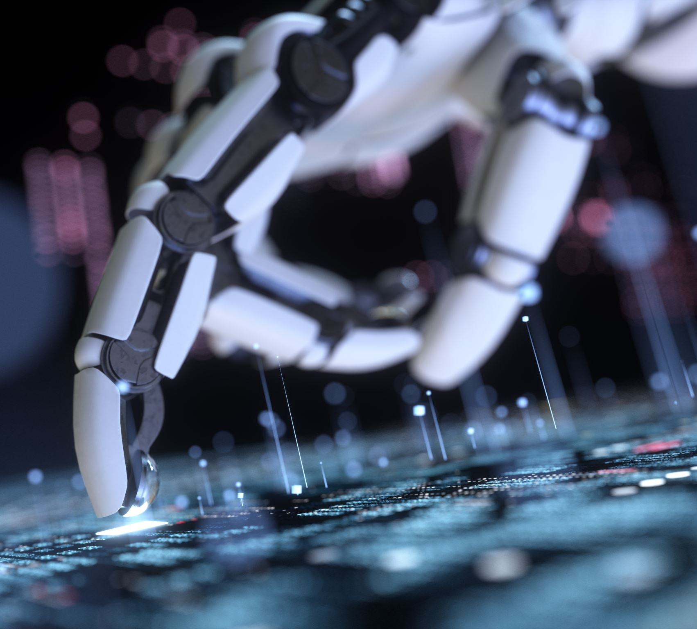
Which haptic technology is the most suitable for the virtual reality and the metaverse? What haptic technologies can do nowadays?
Notes:
Which haptic technology is the most suitable for the virtual reality and the metaverse?
What the haptic technologies can do nowadays?
What is the most convenient solution for the end-user?
Do these technologies have drawbacks for them?
So first, Arthur will start with the state of art

Slide 4
Augmented Reality, Virtual Reality and Metaverse
AR: Overlay digital material in a real-world environment
VR: Three-dimensional artificial immersive environment
Metaverse: A multiuser environment which use AR and VR
Ref: [1], [2]
Notes:
Before we start describing the technology used for haptics, let's define the terms: Augmented Reality, Virtual reality and Metaverse.

Slide 5

State of art: different haptic technologies
Cliquez pour ajouter du texte
Origin
Global definition
Ref: [3]
5/21
Notes:
In the world of virtual immersion, the sense of touch is essential and allows a more complete immersion of the human mind. This is why haptic devices are becoming more and more important in virtual immersion technologies.
A haptic device allows communication between a human and a virtual environment, such as virtual reality or the Metaverse. Also called a tactile kinesthetic system, this type of device is used to design and manipulate objects with tactile feedback. Video games are equipped with these devices, which lets the controller to produce vibrations related to events and actions in games.

Slide 6

Overview
Vibration
Focused ultrasound
Bioelectrical stimulation
Notes:
So yes as we just mentioned before, several technologies exist and in this presentation, we’re going to be focusing on three special technologies that are, nowadays, the most famous ones:
Vibration
Ultrasound
Biolelectrical stimulation
I’m going to start right off the bat with the vibration one.

Slide 7
Vibration
Eccentric Rotating Mass
Linear Resonant Actuator
Piezoelectric Actuator
Surface Actuator
Electroactive Polymers
Capacitive electro-sensory interface
Ref: [4]
Notes:
So first, haptic technologies based on vibrations are the most used ones in the industry today. The sense of touch can be simulated by vibrations, electricity, sound, or heat. Those vibrations can be produced using multiple technologies as you can see here with Eccentric Rotating Mass being the most used one right now. ERM uses a rotational movement and Linear Resonant Actuator has a magnet that moves back and forth for example. And also, LRA is in some consoles like the Nintendo Switch for instance. I’ll let Arthur continue for the ultrasound part.

Slide 8
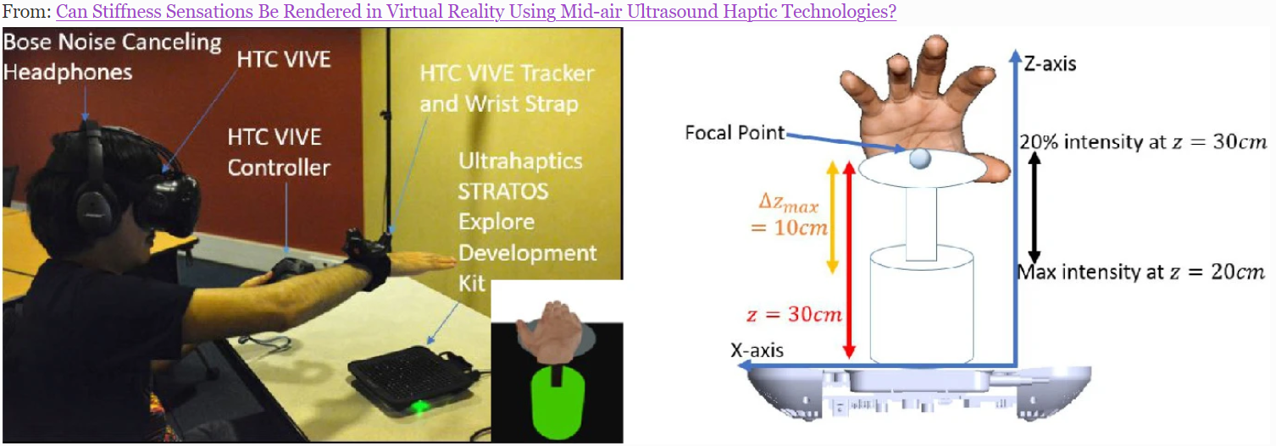
Focused ultrasound
Ref: [4]
Notes:
Pierre
focused ultrasound haptics can provide
the sensation of interacting with objects of different stiffness
HTC Vive + Trackers on dominant wirst + an avatar in the virtual environnement => prouve the ability to sense

Slide 9
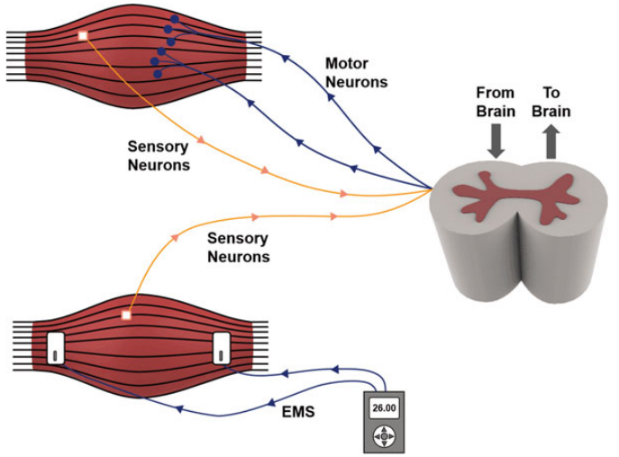
Bioelectrical stimulation
Functional Electrical Stimulation
Electro stimulation
Simulate heat and cold sensation
Ref: [4]
Notes:
Bioelectrical stimulation is a method that allows the user to have haptic sensations thanks to eclectic impulses running through the targeted muscles. The principle is simple, several electrodes are placed at different locations on the user's body. These electrodes will send electricity to the area of the body that the user uses in the virtual world. This technology can also simulate sensations of heat and cold.

Slide 10
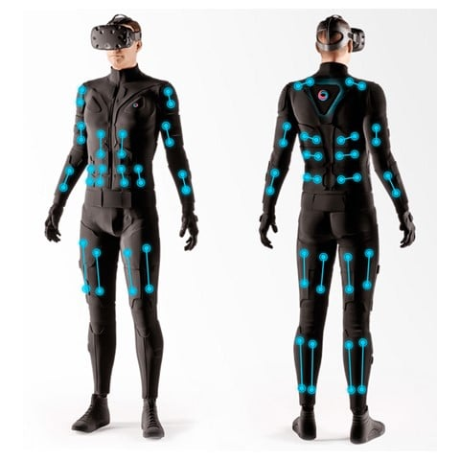
Existing technology: Tesla Suit
Haptic suit
114 electrical sensors
9 axes of motion capture
Ref: [5]
Notes:
The Tesla Suit is a technology using electro-stimulation. This haptic suit is equipped with 114 electrical sensors and the user can move on 9 different axes.

Slide 11

Ethics in the Metaverse
Data issues
Breach of privacy
Securing users' personal data
Phycological harm
Ref: [6]
Notes:
The approach of recent activities conducted on the ethical issue of the Metaverse reveals the data issues.
The increase in realism by the Metaverse technology can be explained by the rise of personal data acquisition through haptic technologies.
Indeed biometric data are collected and also a lot of other information can be recorded, such as character traits, motor actions, reflexes, preferences and habits.
Also,our environment had a powerful influence on our behaviour.

Slide 12

Hypothesis
It is possible to disrupt a user’s inner ear by producing different sounds that allow the user to experience haptic sensations
To enable the development of a networked haptic solution, the data transmission of the haptic technology must consume as little bandwidth as possible
And other…
Notes:
So, after writing the state of the art, our team had several questions that can also be potential client or user questions. For example, we had this question: It is possible to disrupt a user’s inner ear by producing different sounds that allow the user to experience haptic sensations? Like what are the drawbacks of that technology? And other hypotheses. To answer that we needed real articles and real experiences and that’s actually the next part of our study.

Slide 13
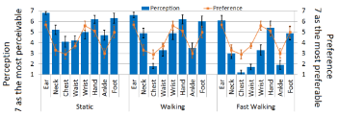
Electrical nerves stimulation
10 young subjects (7 males & 3 females)
1200 rpm (rotation per minute)
200 Hz of frequency
2.5 seconds between each vibration
Sensation : 1 to 7 on the Likert scale
Ref: [7]
Notes:
Several experiments have been carried out in the field of nerve stimulation by electrical impulse. This experiment, for example, was performed by 10 subjects and the goal was to determine which area of the body was more sensitive to electrical haptic sensations. Each participant then gave a score between 1 and 7 to determine the most sensitive area. 7 being the most sensitive so we can observe that the ear and the hand are the most sensitive body parts.

Slide 14
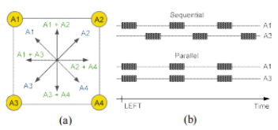
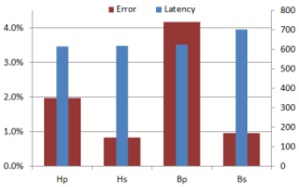
Electrical nerves stimulation
20 young subjects
2 sensors on the sides of their forehead
2 sensors on the neck
2 sensors on the back
Sequential and parallel stimulation
Different impulsion for different directions
Ref: [7]
Notes:
This second experiment was performed with 20 participants. Several sensors were placed on different parts of their bodies and several parallel and sequential electrical stimulations were performed. The objective of this study was to see the reaction time of the user before and after an electrical pulse in a random direction. We can observe that sequential stimulation has less error but a higher latency.

Slide 15
Shockwaves for Haptic Sensations
iCone: 7m diameter, 270° FOV, conical shape, 16 speakers
Reproduce touch thanks to vibration through the body
Use subwoofers to generate vibrations
Inefficient because users don’t realize the haptic effect
Jolt users body
Haptic effects due to the user’s bone structure
Can cause health problem for some effects (blast for example)
Enhance tactility of the sound
Can be used to reproduce motion, collision in completion of a sound system
Many constraints with deployment
Ref: [8]
Notes:
Pierre

Slide 16
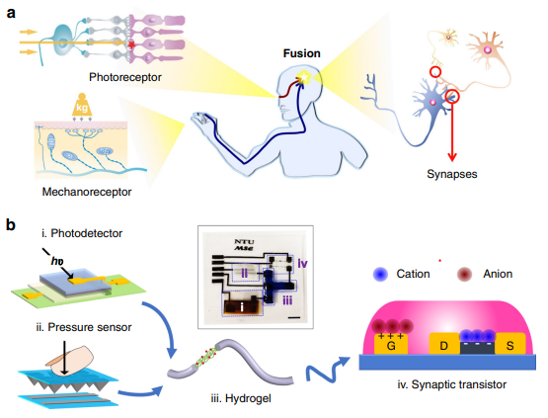
Haptic sensation by stimulating neural activity
Biological systems always outshine their electronic counterparts
Superior fault tolerance and power efficiency
Hybrid neurons
Visual channel
Haptic channel
Ref: [9]
Notes:
Haptic simulation can also be recreated by stimulating neural networks. In the document “An artificial sensory neuron with visual-haptic fusion”.
To experiment the sensations of touch and vision, a bimodal artificial sensory neuron (BASE) has been developed. This neuron is based on a
Hybrid neural circuits are mainly characterised by the visual channel and the haptic channel. The visual channel includes a photodetector and represents the photoreceptors of the human retina. The haptic channel consists of a pressure sensor that incorporates microstructures in the top layer of the polycoating. Experimental results show that when pressure is applied to the top layer, it forms a resistive path with the electrodes on the bottom layer.
Such neuronal system analyzes multiple sensory cues efficiently to establish accurate depiction of the environment

Slide 17
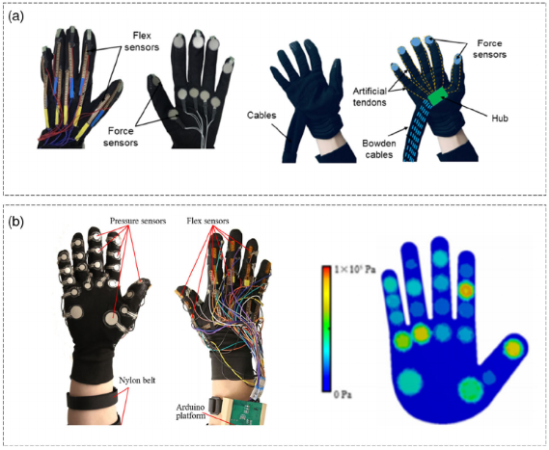
Haptic Gloves
Ref: [10]
Notes:
Here, the glove is composed of vibrating sensors at the fingertips, which creates an artificial resistance. The sensor sheets are composed of three vibrators and ten sensors to simulate the sensation of touching the object. The heated sheets give a thermo-haptic sensation of an object to the user. The glove was tested in “Smart Tactile Gloves for Haptic Interaction” with a simulated badminton racket and demonstrated a great ability to simulate haptics.

Slide 18
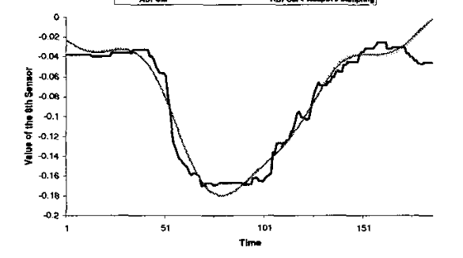
Data transmission
Position | 1 | 2
Without compression | 122 | 123
With Floating-point compression |  | +1
Comparison of the original signal to the recomposed signal after compression
Ref: [11]
Notes:
Two experiments were performed, one on sampling a signal and the other on compressing the coordinates of haptic devices. The two previous experiments exploit two different compression methods: the combination of ADPCM and AS for signal strength and the floating-point method to compress the coordinates.

Slide 19
Hypothesis answer
It is possible to disrupt a user’s inner ear by producing different sounds that allow the user to experience haptic sensations.
To enable the development of a networked haptic solution, the data transmission of the haptic technology must consume as little bandwidth as possible.
=> The inner ear does not act on the sensation of touch but of movement.
=> The solution will use compression systems and multiplexing systems to use less bandwidth
Ref: [8], [11]
19/21
Notes:
Pierre

Slide 20
Result comparison
Haptic technologies | Benefits | Drawbacks
Sound stimulation | Makes touch sound effects Adapt to collision simulation | Disturbs the inner ear Negative health effects Very bulky device
Electric stimulation | True-to-life sensations Easy to put in place Easy to use for the user | Poorly calibrated it can be painful
Mechanic stimulation | Faithful sensations of inertia and force of movement Easy to set up | Challenging movement in the real world Fragility of the physical device
Temperature stimulation | Reinforces feelings of reality Simulate hot or cold surfaces | Poorly calibrated it can make extreme sensations Inaccurate for texture sensations
Neural network stimulation | Ability to simulate sight and/or hearing Copies the functioning of a human neuron | Difficult to set up Little used to date Still in the pre-test phase
Notes:
After reviewing our experiences that we just talked about, and others, we noticed that the best haptic technology was the electrical stimulation one. Indeed others, as noted in this table, have some chances to affect the user’s physical conditions which is obviously very bad. While, on the other hand, electrical stimulation are very promising according to the scientists. It should be taken into account that other technologies like neuronal simulation are slowly appearing and are already very promising too but can’t be commercialized yet.

Slide 21
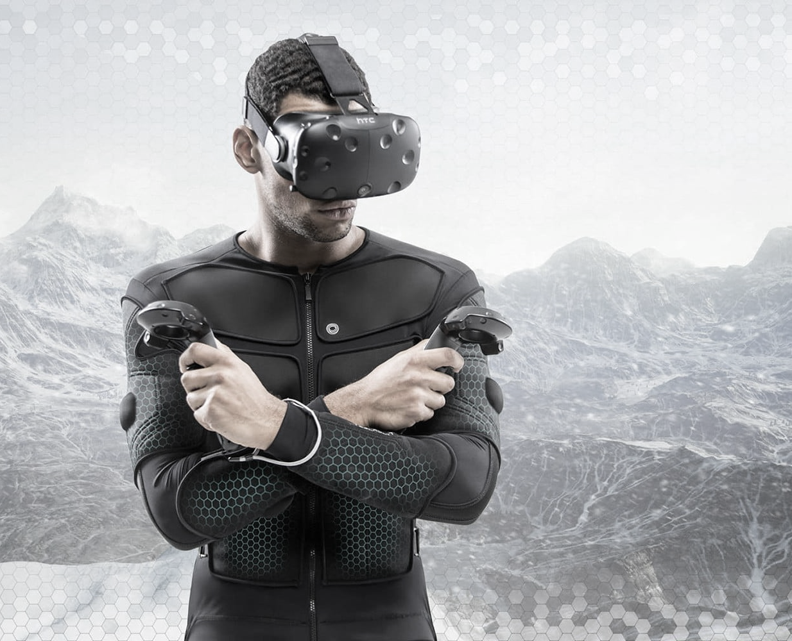
Conclusion
Thanks for listening
Notes:
So, to conclude, The sensation of touch in virtual reality can be simulated by many haptic technologies. Those can be based on vibration, heat, sound waves or even electrical impulses. But experiences have shown that electrical stimulation is the best option today because of the great experience felt by the end-user since it has no negative consequences in comparison to others. Electrical stimulation is also relatively easy to be implemented and provide an accurate haptic sensations as long as the ethic aspect is respected.
Our team already see the potential behind this solution and especially in some fields related to services in VR and metaverses, such as fashion, social medias, or even military. Also, in the future, neuronal solutions seem to be conclusive, and scientists are positives that new technologies and services will soon emerge in that specific field.
So, I really expect, you enjoyed our presentation, Thanks for listening.

Slide 22
References
Seokhee Jeon; Seungmoon Choi. “Stiffness modulation for Haptic Augmented Reality: Extension to 3D interaction”. In: (2010).
Stylianos Mystakidis. “Metaverse”. In:(2022).
M.Sreelakshmi; T.D.Subas. “Haptic Technology: A comprehensive review on its applications and future prospects”. In: (2017).
Shuo GaoShuo; YanHang Zhao; Arokia Nathan. “Touch-Based Human-Machine Interaction”. In: (2021).
Teslasuit. “TESLASUIT DK1 SPECIFICATION”. In: (2021)
Carlos Bermejo Fernandez; Pan Hui. “Life, the Metaverse and Everything: An Overview of Privacy, Ethics, and Governance in Metaverse”. In: (2022).

Slide 23
References
Oleg Špakov; Jussi Rantala; Poika Isokoski.“Sequential and simultaneous tactile stimulation with multiple actuators on head, neckand back for gaze cuing”. In: (2015).
Ernst Kruijff; Aeldrik Pander. “Experiences of using Shockwaves for Haptic Sensations”. In: (2005).
Changjin Wan; Pingqiang Cai; Xintong Guo; Ming Wang; Naoji Matsuhisa; LeYang; Zhisheng; Yifei Luo; Xian Jun Loh; Xiaodong Chen. “An artificial sensory neuron with visual-haptic fusion”. In: (2020).
Mark Paterson. “The Senses of Touch: Haptics, Affects and Technologies”. In: (2020).
C. Shahabi, A. Ortega, and M.R. Kolahdouzan. “A comparison of different haptic compression techniques”. In: (2002).

Slide 24
Annexes
Poster:

